Slide 1
Verilog

Slide 2
4-Value Logic
Four values:
0, 1, x, z.
x: unknown value
z: high impedance
and | 0 | 1 | x | z
0 | 0 | 0 | 0 | 0
1 | 0 | 1 | x | x
x | 0 | x | x | x
z | 0 | x | x | x
input | not
0 | 1
1 | 0
x | x
z | x
or | 0 | 1 | x | z
0 | 0 | 1 | x | x
1 | 1 | 1 | 1 | 1
x | x | 1 | x | x
z | x | 1 | x | x

Slide 3
Vectors
output [0:3] D;
wire [7:0] SUM;
indexing:
D[3]
slicing:
SUM[5:2]

Slide 4
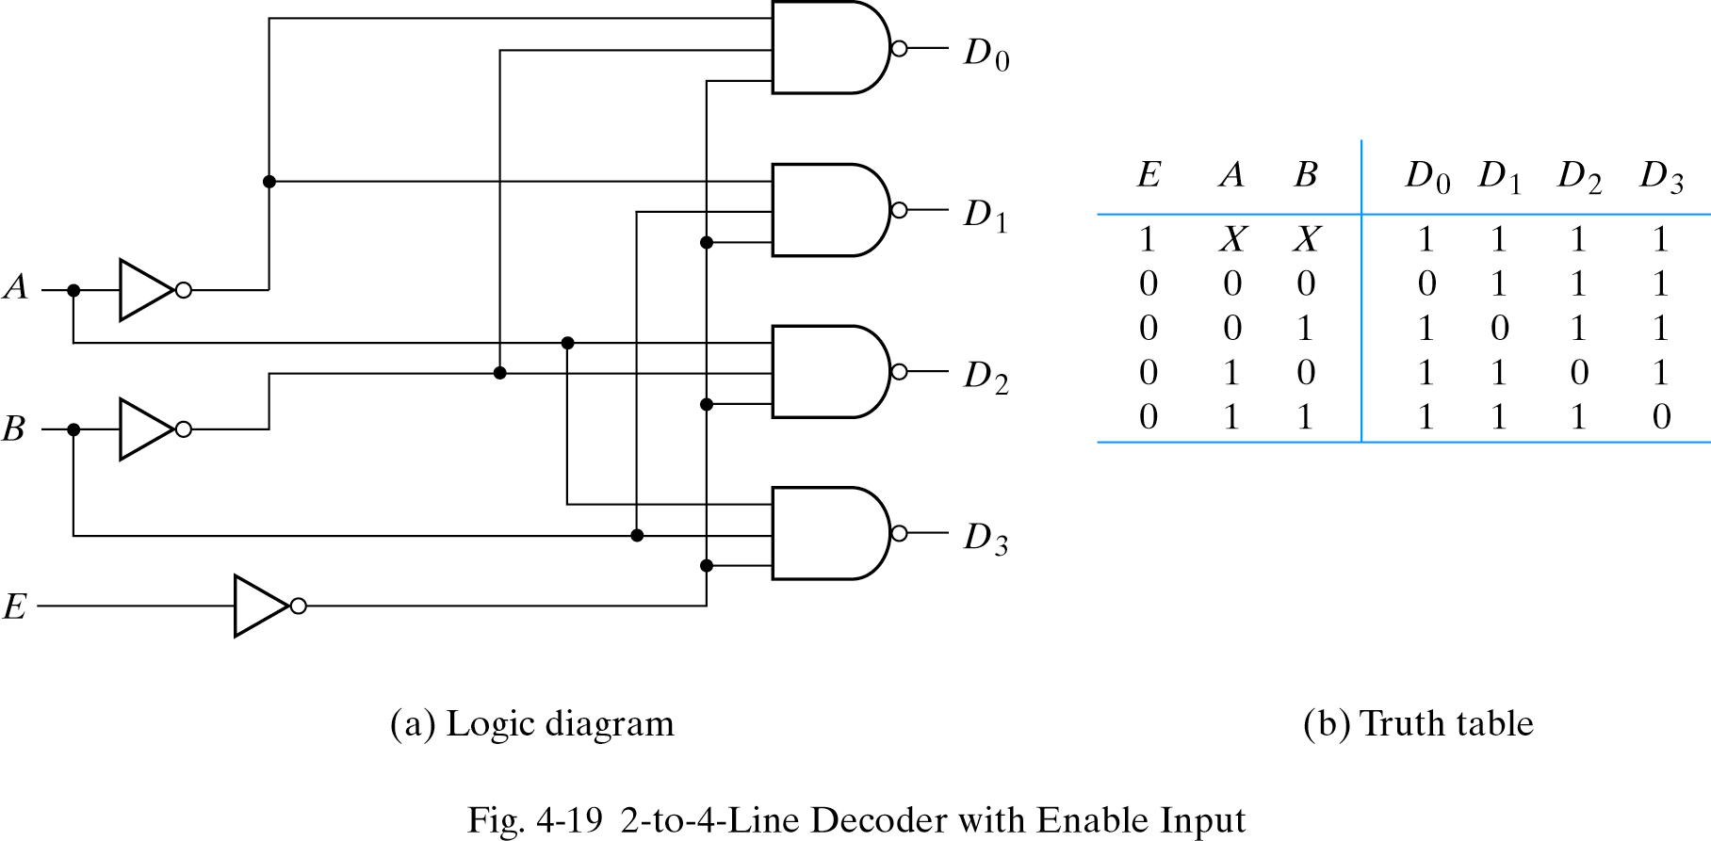
Decoder
//HDL Example 4-1
//----------------------------------------
//Gate-level description of a 2-to-4-line decoder
//Figure 4-19
module decoder_gl (A,B,E,D);
input A,B,E;
output [0:3] D;
wire Anot,Bnot,Enot;
not
n1 (Anot,A),
n2 (Bnot,B),
n3 (Enot,E);
nand
n4 (D[0],Anot,Bnot,Enot),
n5 (D[1],Anot,B,Enot),
n6 (D[2],A,Bnot,Enot),
n7 (D[3],A,B,Enot);
endmodule
Gate-level description
nands and nots are grouped.

Slide 5
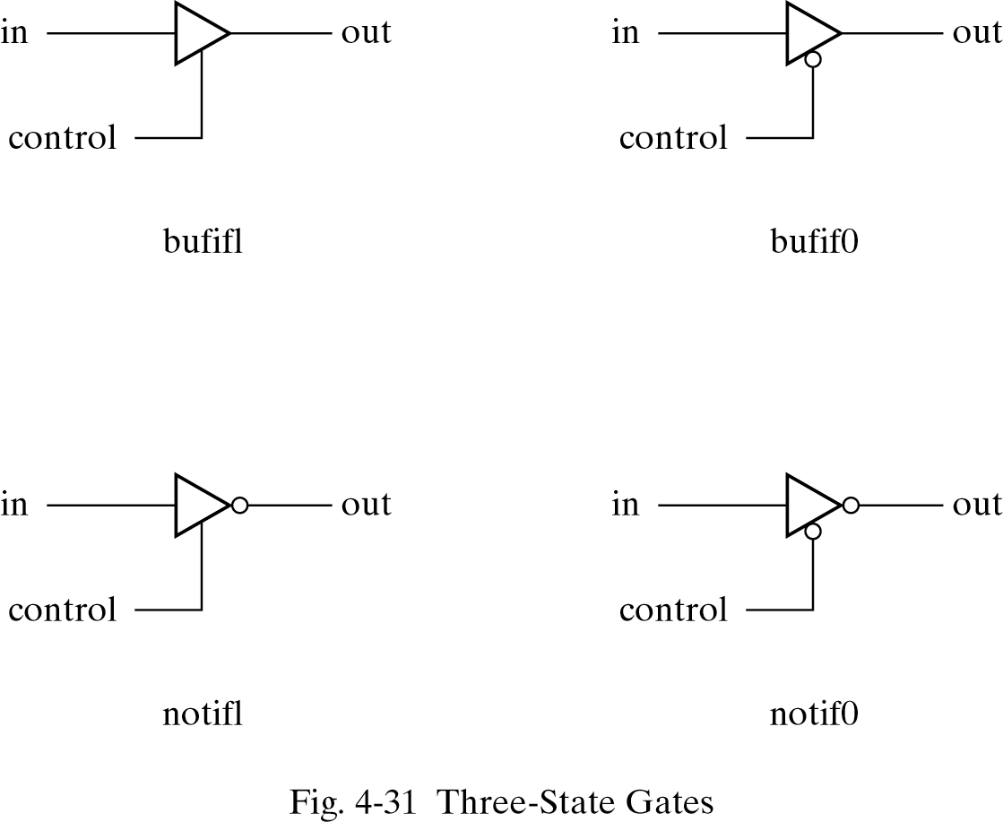
Buffers
gateName (output, input, control);
bufif1 (OUT, A, control);
notif0 (Y, B, enable);

Slide 6
Multiplexer
tri:
a net which has the capability of being driven by several drivers.
types of nets:
wire, tri, supply1, supply0, wand, wor.

Slide 7
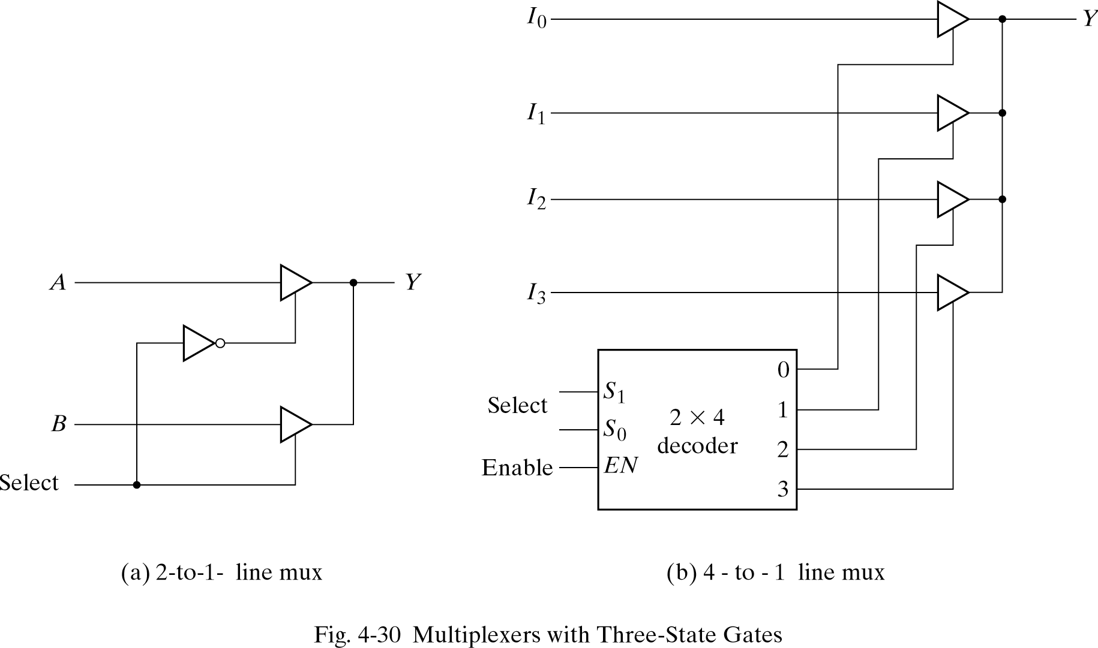
Multiplexer
tri:
a net which has the capability of being driven by several drivers.
types of nets:
wire, tri, supply1, supply0, wand, wor.
OUT
module muxtri (A, B, select, OUT);
input A, B, select;
output OUT;
tri OUT;
bufif1 (OUT, A, select);
bufuf0 (OUT, B, select);
endmodule;
Correct?

